Slide 1
Sheltered English Instruction Teacher Endorsement Course
Introduction to Course, Policy & Data
Notes:
Purpose: To welcome participants, introduce yourself and the course.
Time: 3 min.
Procedure: Explain how the first part of the lesson today will welcome participants, and will provide important background information, as well as an overview of the course. Introduce yourself as the facilitator and provide some background information.

Slide 2
Agenda
Introduction of course
Purpose of the course
Method of the course
Content of the course
What this means for us, the ELL teacher
Questions/Comments/Ideas
Notes:
Purpose: To describe the activities and pace of the session.
Time: 2 min
Procedure: Facilitator summarizes the main sections of the first course session. The agenda is in the Participant Manual as well.

Slide 3
RETELL Initiative SEI Endorsement Course
Who is designing the course?
Why are they making such a large push now?
Who can take the course?
Who should take the course?
Free vs. Pay / Cohorts
Notes:
Purpose: To highlight where Session 1 fits in the larger context of the course.
Time: 2 min
Procedure: Facilitator explains how Session 1 sets the stage for understanding the ELL student population in MA, legal and curricular expectations for ELL instruction, and the need to develop a collaborative approach for promoting ELL language development and academic achievement. In addition, the facilitator will explain how strategy implementations that are practiced throughout the course culminate in the final capstone project.

Slide 4


Core academic teachers who work with ELLs (SEI Teachers) need the SEI Endorsement
Provides a foundation of understanding, knowledge, and skills critical to SEI in core academic areas
4
Massachusetts Department of Elementary and Secondary Education

Slide 5
Types of courses:
Administrator course
Short Bridge
Long Bridge
Full Course: 3 Graduate Credits.
Notes:
Purpose: To provide an overview of the SEI Teacher Course attendance policy
Time: 2 min
Procedure: Facilitator summarizes the slide, focusing on talking points outlined below. Attendance policy is also included in the syllabus.
Talking Points:
Participants can take the course pass/fail or for credit. In order to pass, participants need a grade of C or above. Participants must pass the course to earn the Endorsement.
If a participant is assigned to the course and is unable to complete the course due to serious illness or injury, or other circumstances beyond the educator’s control, he or she may ask the Department of Elementary and Secondary Education for a hardship exception allowing additional time to meet the requirements for the SEI Endorsement.
Attendance is very important. Tardiness and absences can affect the final grade. Participation is worth 20% of final grade. Participation in online assignments and forums will also be factored into the final grade. Grading rubrics can be found in the Particpant Manual.
Participants can take the course for graduate credit. It is their responsibility to register and pay for the course. A list of the Institutions offering credit for the SEI Teacher Endorsement course can be found on the DESE website on the RETELL page, at http://www.doe.mass.edu/retell/credit.html. It is important for all participants to complete the poll in Blackboard to indicate whether they are seeking graduate credit
5) Explain how the online component of the course includes submission of assignments. Check with participants to see who has had an opportunity to log on already. Log on instructions can be found in the participant’s manual.
Online troubleshooting: Encourage participants to go to http://ese.echelp.org/ to answer Blackboard questions or be connected directly with support.. If participants want to troubleshoot login issues, encourage them to talk to you during break or after class.
The direct URL to Blackboard is: https://dese.umassonline.net

Slide 6
Course Map
MODULE A: ELLs: Their World and Second Language Acquisition Process in the SEI Classroom
Introduction to Course, Policy, and Data (Face-to-Face; 3 hours) | WIDA Plus (Online; 1 hour) | Diversity, Cultural & Social Aspects of Teaching ELLs (Face-to-Face; 3 hours) | Second Language Acquisition (Online; 1 hour) | Overview of SEI (Face-to-Face; 2 hours)
MODULE B: Academic Language and Literacy Development in the SEI Classroom
VOCABULARY AND DISCOURSE FOR ELLS
Vocabulary Part 1 (Online; 1.5 hours) | Vocabulary Part 2 (Face-to-Face; 3 hours) | Vocabulary Part 3 (Online; 1 hour) |  | Vocabulary Part 4 (Face-to-Face; 3 hours)
READING COMPREHENSION FOR ELLS
Reading Part 1 (Online; 1.5 hours) | Reading Part 2 (Face-to-Face; 3.5 hours) | Reading Part 3 (Online; 1 hour) |  | Reading Part 4 (Face-to-Face; 3 hours)
WRITING FOR ELLS
Writing Part 1 (Online; 1 hour) | Writing Part 2 (Face-to-Face; 3.5 hours) | Writing Part 3 (Online; 1 hour) |  | Writing Part 4 (Face-to-Face; 3 hours)
Instructional Integration (Face-to-Face; 3 hours)
ASSESSMENT AND CAPSTONE
Capstone I Presentations (Face-to-Face; 3.5 hours) |  |  | Capstone II Presentations (Face-to-Face; 3 hours)
Notes:
Purpose: To provide an overview of the options for seeking graduate credit
Time: 1 min
Procedure: Facilitator summarizes the slide, focusing on talking points outlined below.
Talking Points:
Participants can take the course for graduate credit. It is their responsibility to register and pay for the course. A list of the Institutions offering credit for the SEI Teacher Endorsement course can be found on the DESE website on the RETELL page, at http://www.doe.mass.edu/retell/credit.html.
It is important for all participants to complete the poll in Blackboard to indicate whether they are seeking graduate credit so that grades are appropriately transferred at the end of the course.

Slide 7

II. Purpose of the Course
Designed to provide ELLs access to effective instruction and close proficiency gaps.
ELL Student Global Development
WIDA English Language Development Standards
ACCESS for ELLs Assessment
Sheltered English Instruction (SEI) Endorsement & Course
7
Massachusetts Department of Elementary and Secondary Education
Notes:
Purpose: To introduce the final project for the course.
Time: 10 min (for 2 slides)
Procedure: Walk participants through the SEI Lesson Tool in the participant manual.
Specifically, introduce the capstone final project. Facilitator explains the SEI Lesson Tool, the expectations for final presentations and the role of participants to provide feedback. The final Capstone Tool can be found in the participant’s manual as well as on Blackboard.
Talking Points:
The final course project has been designed as an opportunity to integrate knowledge and understanding of Sheltered Instruction principles and strategies to support your students’ content learning and language development.
Please note that, depending on your context of teaching, the length of your Capstone Lesson may vary.
Participants will create and teach a lesson using the SEI Lesson Tool. They will then reflect on the implementation and present a component of that lesson in the one of the final sessions of the SEI Endorsement course. They might choose to focus either on the most challenging or the most successful aspect of the lesson implementation to reflect on and present. Time allocated for each individual presentation will include five minutes for peer feedback.

Slide 8

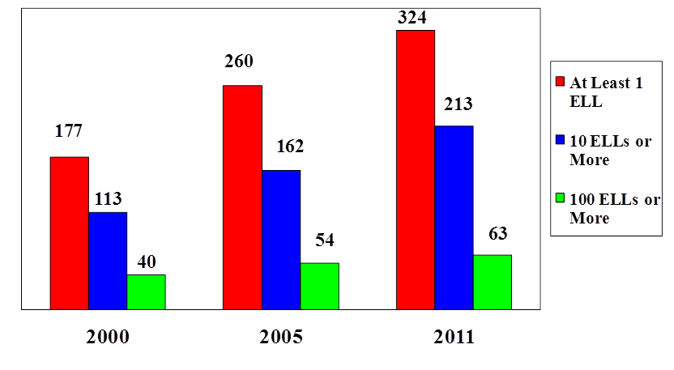
8
Massachusetts Department of Elementary and Secondary Education

Slide 9

SY2012: 73,217
SY2000: 44,747
67%
9
Massachusetts Department of Elementary and Secondary Education

Slide 10

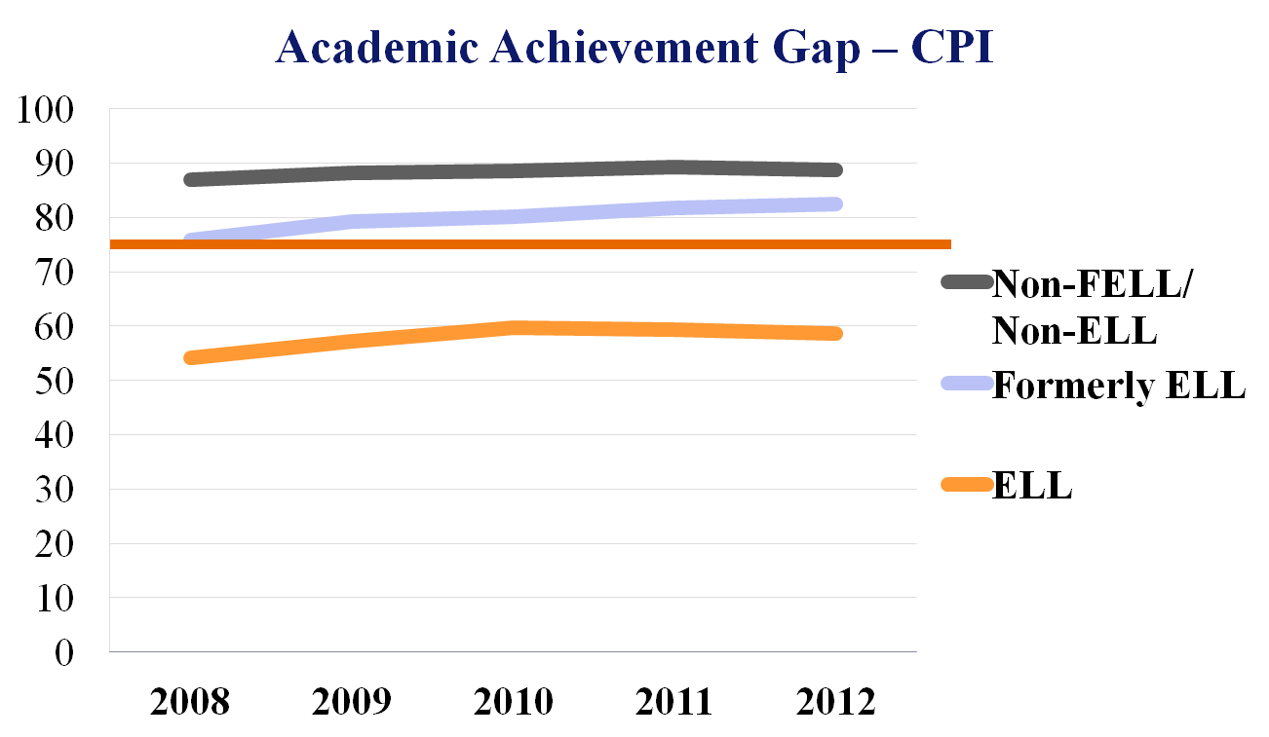
10
DART for ELLs 2012
Massachusetts Department of Elementary and Secondary Education

Slide 11


Equal access to high quality education
Federal laws, guidance, and court cases
    Civil Rights Act, 1964
    Equal Educational Opportunity Act (EEOA), 1974
    Lau v. Nichols, (1974)
    Castañeda v. Pickard, (1981)
    Office of Civil Rights Guidelines
    NCLB Title III, 2002
Massachusetts
    MA Education Reform Act, 1993
    Ballot Question 2
    Title III priorities in MA
    RETELL Regulations
11
Massachusetts Department of Elementary and Secondary Education

Slide 12

“Who’s responsible for student learning? Walk into an effective school and ask this question of anyone – a teacher, a student, the principal, a parent volunteer, a secretary – and you’ll get the same answer: I am.”
(Conzemius & O’Neill, 2001)
“It is time to break the bad habit of expecting something from nothing, from our government or from each other. Let us all take more responsibility, not only for ourselves and our families, but for our communities and our country.”
(Clinton, 1993)
Who is responsible? We all are!
12
Massachusetts Department of Elementary and Secondary Education

Slide 13

Design, teach, and reflect on an integrated SEI lesson that
  Addresses all four language domains – speaking, listening, reading, and writing
  Infuses strategies introduced in the Sheltered English Instruction course
  Is consistent with the Massachusetts curriculum and WIDA frameworks
13
Massachusetts Department of Elementary and Secondary Education
Notes:
(continuation of previous slide)
Purpose: To introduce the final project for the course.
Time: 3 min
Procedure: Walk participants through the SEI lesson tool in the participant manual.
Specifically, introduce the capstone final project. Facilitator explains the SEI Lesson Tool , the expectations for final presentations and the role of participants to provide feedback. The final capstone tool can be found in the participant’s manual as well as on Blackboard.
Talking Points:
The final course project has been designed as an opportunity to integrate knowledge and understanding of Sheltered Instruction principles and strategies to support your students’ content learning and language development.
Please note that, depending on your context of teaching, the length of your Capstone Lesson may vary.
Participants will create and teach a lesson using the SEI Lesson Tool after the Integration session and before their Capstone presentation. They will then reflect on the implementation and present a component of that lesson in the one of the final sessions of the SEI Endorsement course. They might choose to focus on the most successful aspects or refinements of your Capstone Lesson Implementation. Time allocated for each individual presentation will include five minutes for peer feedback.

Slide 14
For this assignment participants will
  Select one specific class as a focus
  Design a lesson plan w/SEI Lesson Tool
  Teach
    Lesson to students in their classroom
    A component of the Capstone Lesson to course colleagues during one of the two final sessions
  Write a reflection on its planning and implementation.
14
14
Massachusetts Department of Elementary and Secondary Education
Massachusetts Department of Elementary and Secondary Education

Slide 15
III. Method of the course
Online
Face to Face
Modeling Strategies
Delivering content
Classroom application
Reflection

Slide 16
IV. Content of Class
Getting people to care and understand
Teaching them what to do and how to do it.
Practicing
Notes:
Purpose: To introduce content objectives for this session.
Time: 1 min.
Procedure: Read or have participant volunteers read the objectives.

Slide 17
Getting People to Care and Understand
http://youtu.be/I6Y0HAjLKYI
http://youtu.be/p7AjmK77BWM?t=2m22s
Margarita Calderon: Implementing Peer-Assisted Learning Video on YouTube
Notes:
Purpose: To provide background on the RETELL initiative
Time: 3 min
Procedure: Facilitator summarizes the slide focusing on talking points outlined below.
Talking Points:
The RETELL initiative is designed to provide ELLs access to effective instruction and close proficiency gaps.
The RETELL initiative is a comprehensive approach including three key components: adoption and implementation of the WIDA English Language Development Standards, monitoring student progress through the ACCESS for ELLs assessment, and professional development on effective instruction for ELLs through the SEI Teacher and Administrator Endorsements and corresponding courses.

Slide 18
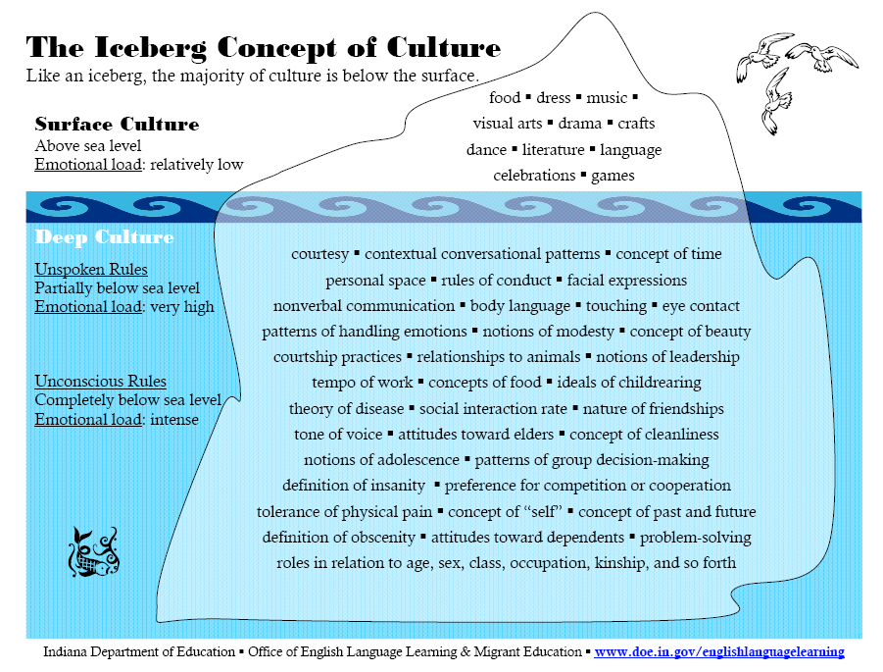
Iceberg of Culture
Indiana Department of Education 􀂃 Office of English Language Learning & Migrant Education 􀂃 www.doe.in.gov/englishlanguagelearning
The Iceberg Concept of Culture
Like an iceberg, the majority of culture is below the surface.
food 􀂃 dress 􀂃 music 􀂃
visual arts 􀂃 drama 􀂃 crafts
dance 􀂃 literature 􀂃 language
celebrations 􀂃 games
courtesy 􀂃 contextual conversational patterns 􀂃 concept of time
personal space 􀂃 rules of conduct 􀂃 facial expressions
nonverbal communication 􀂃 body language 􀂃 touching 􀂃 eye contact
patterns of handling emotions 􀂃 notions of modesty 􀂃 concept of beauty
courtship practices 􀂃 relationships to animals 􀂃 notions of leadership
tempo of work 􀂃 concepts of food 􀂃 ideals of childrearing
theory of disease 􀂃 social interaction rate 􀂃 nature of friendships
tone of voice 􀂃 attitudes toward elders 􀂃 concept of cleanliness
notions of adolescence 􀂃 patterns of group decision-making
definition of insanity 􀂃 preference for competition or cooperation
tolerance of physical pain 􀂃 concept of “self” 􀂃 concept of past and future
definition of obscenity 􀂃 attitudes toward dependents 􀂃 problem-solving
roles in relation to age, sex, class, occupation, kinship, and so forth
Surface Culture
Above sea level
Emotional load: relatively low
Deep Culture
Unspoken Rules
Partially below sea level
Emotional load: very high
Unconscious Rules
Completely below sea level
Emotional load: intense
Notes:
Purpose: To discuss the many concepts of culture
Time: 5 min
Procedure: Facilitator explains the slide, reading or having a participant read, the various things listed in surface and deep culture. Note the unspoken and unconscious rules.
Talking Points: As discussed, an iceberg works well to illustrate that various aspects of culture exist at the surface level and are clearly visible while others remain hidden. The hidden aspects can be deep-seated on a subconscious level. Prompt participants to share what they added to the iceberg and where. Discuss the difference between the idea of unspoken rules and unconscious rules.
Give and solicit examples for some of these concepts.
Attitudes toward elders: who cares for the elderly ?
Notions of modesty: how much skin is ok to show?
Touching: are public displays of affection ok?
Work tempo: how much vacation?
Which of these might be unspoken, which unconscious?
Note that this graphic is also in the PM.
18

Slide 19
Culture: Hidden or Apparent
  “We cannot understand cultures completely, but we can know and accept that we do not understand everything; we can be prepared to learn from as well as with the students in our schools.” Ovando, Combs, Collier 2006
Do hidden aspects of culture manifest with the ELLs in your school/classroom?
19
Notes:
Purpose: To highlight the many aspects of a student’s life that fall under the umbrella term: culture
Time: 3 min
Procedure: Facilitator or a volunteer reads the slide. Participants discuss the question prompt in table groups, followed by whole group discussion.
Talking points: Considering the discussion of unspoken and unconscious aspects of culture, prompt participants to consider evidence of those aspects that may be evident in their class or school. Are there behaviors or actions that might be explained by this understanding of culture?
19

Slide 20


Newcomers
Different English proficiency levels
Grade-level/advanced content knowledge
Gifted and talented
Special Education
Students with Limited or Interrupted Formal Schooling (SLIFE)
20
Massachusetts Department of Elementary and Secondary Education
Notes:
Purpose: To model how participants can use sentence frames to analyze MA ELL demographic data
Time: 5 min
Procedure:
Facilitator asks participants guiding questions for analyzing data:
What do you see?
What inferences/conclusions can you draw from this data?
Do you have any questions? Is there anything else you want to know about?
Facilitator models potential answers to the questions and highlights sentence frames participants can use for each type of question:
Observation: I see that the total number of districts with at least 1 ELL increased more than the number of districts with 100 or more ELLs in the last 11 years. The total number of districts with at least 1 ELL increased by 137, while the number of districts with 100 ELLs or more increased by 13.
Inference: I think this means that many more MA educators teach at least 1 ELL now than in 2000.
Additional Questions: I wonder whether they have a map where I can see where the number of enrolled ELLs has increased in MA. Is there at least 1 ELL in each MA school district?
Ask Participants to share other observations, inferences, or additional questions about this data

Slide 21
Once they care… What should they do?
Understand their student’s proficiency level using WIDA
Analyze their class/content texts and materials
Use strategies to
  match content delivery to student proficiency and
  match assessments to proficiency level of ELL

Slide 22
Notes:
Purpose: To present data showing the increase of ELLs in the state since 2000-2013
Time: 1 minute
Procedure:
Talking Points:
We can see that the number of ELLs in Massachusetts schools has grown by 67% in 12 years.
The number of ELLs is increasing and will continue to increase.

Slide 23
Core Strategies
Vocabulary
  7 Steps
  Tiered Vocabulary
  Cognate Awareness
  Sentence Frames
  Word Wheels
  Lexical Arrays
  Word Form Chart
  Word Families
23
* More examples in participant manuals
Massachusetts Department of Elementary and Secondary Education
Notes:
Purpose: To display the variety of strategies explored throughout the course
Time: (Continued)
Talking Points:
Research consistently demonstrates that multiple use of core strategies for language and content development in a systematic way has a dramatic impact on achievement.
These strategies are highlighted in this course because they promote academic English and content development, can be applied in multiple content areas and grade levels, and promotes oral language development and critical thinking
23

Slide 24
Core Strategies
Reading
  Identifying and Analyzing Text Features
  Think-aloud
  Reciprocal Teaching
  Partner Reading
  Analyzing Text Genres and Organization
  Close Reading with Text-dependent Questions
  Double Entry Journals
24
* More examples in participant manuals
Massachusetts Department of Elementary and Secondary Education
Notes:
Purpose: To display the variety of strategies explored throughout the course
Time: (Continued)
Talking Points:
Research consistently demonstrates that multiple use of core strategies for language and content development in a systematic way has a dramatic impact on achievement.
These strategies are highlighted in this course because they promote academic English and content development, can be applied in multiple content areas and grade levels, and promotes oral language development and critical thinking
24

Slide 25
Core Strategies
Writing
  Cut-n-Grow
  Information Gap
  Language Experience Approach (LEA)
  RAFT
  Ratiocination
  Round Table
  Sentence Combining
  Write-around
25
* More examples in participant manuals
Massachusetts Department of Elementary and Secondary Education
Notes:
Purpose: To display the variety of strategies explored throughout the course
Time: (Continued)
Talking Points:
Research consistently demonstrates that multiple use of core strategies for language and content development in a systematic way has a dramatic impact on achievement.
These strategies are highlighted in this course because they promote academic English and content development, can be applied in multiple content areas and grade levels, and promotes oral language development and critical thinking.
25

Slide 26
Interaction Strategies
Anticipation Guide
Clock Buddies
Continuum
Divide & Slide
Exit Ticket
Expert Groups
Final Word Protocol
Gallery Walk
Graphic Organizers
Jigsaw
Last One Standing
Numbered Heads Together
Quick Write
Snowballs
Thinking Notes
Think-Write- Pair-Share
  T-P-S
  T-P-Square-S
Turn & Talk
Visual Scaffolding
Zip Line
26
Massachusetts Department of Elementary and Secondary Education
Notes:
Purpose: To display the variety of interactive strategies used that promote oral language and comprehension
Time: 15 minutes
Procedure:
Display the additional strategies used and discussed throughout the course, reviewing a few of them.
Highlight that that these were strategies implemented to give participants an opportunity to process concepts, but for ELLs these strategies are essential for students to develop oral language skills and comprehension of concepts.
Ask participants to turn to a neighbor and identify those strategies that they now utilize on a consistent basis and ones they would like to use more often.
Talking Points:
Remember that Ester de Jong states that interactive strategies enable native English speaking students to process concepts or “talk to learn”, but English language learners are “learning to talk” and may need supports and explicit instruction on how to express their knowledge when using these interactive strategies.
26

Slide 27
V. What does this mean for us and for content teachers?
Clear roles and expectations!!
Notes:
Purpose: To introduce laws and regulations in place to ensure ELLs have equal access to high quality education
Time: 3 min.
Procedure: Facilitator introduces the many laws and regulations established to ensure ELLs have equal educational opportunity/access to high quality education. Summarize key laws, guidance, and court cases on the slide.
Talking Points:
American language policy changed as a result of the Civil Rights Movement. Today there are several laws and regulations to ensure ELLs have equal access to high quality education. Both the federal government and the state of MA have actively protected the educational rights of ELLs.
Federal level laws, guidance, and court cases protecting ELLs rights: Civil Rights Act, 1964 ; Equal Educational Opportunity Act (EEOA), 1974; Lau v. Nichols, 1974; Castañeda v. Pickard, 1981; Office of Civil Rights Guidelines; NCLB Title III, 2002

Slide 28

Requirements for Instruction of ELLS
Meaningful Access to Curriculum
ESL Instruction
Explicit, direct instruction in English to promote English language development
Sheltered English Instruction (SEI)
Differentiated instruction that includes approaches, strategies and methodology that makes the content comprehensible and promotes academic English language development
Bilingual or Dual Language Instruction*
MUST provide both!
28
Massachusetts Department of Elementary and Secondary Education
Notes:
Purpose: To continue highlighting the idea of shared responsibility
Time: 3 min.
Procedure: Facilitator asks for a volunteer to read the quotes. Facilitator elicits comments from the participants about the quotes, asking: According to these quotes, who’s responsible for ELLs’ success in school? Do you agree or disagree with the quotes?
Talking points:
1) Laws and regulations promote shared responsibility for ELLs’ success.
2) Research about effective schools highlights the impact of shared responsibility.
3) In MA, the WIDA ELD standards and 2011 MA Curriculum Frameworks expect content area teachers and ESL teachers to focus on promoting academic language development and academic achievement of ELLs.
Revision suggestions by S Slakk 4 Jun 13
28
12/5/2013

Slide 29
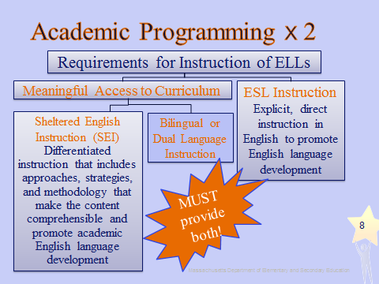
English as a Second Language
  What is ESL?
  Taught by a licensed ESL (or ELL) teacher
  Based on ESL curriculum
  Integrates language domains: listening, speaking, reading, & writing
  Is for ELLs only
Definition: Explicit, direct instruction in English to promote English language development
29
Massachusetts Department of Elementary and Secondary Education
Massachusetts Department of Elementary and Secondary Education. 2006
Notes:
Purpose: To contrast ESL instruction with SEI and underscore the need for both
Time: 2 min
Procedure:
Talking Points:
Taught by a licensed ESL (or ELL) teacher
Based on an ESL curriculum
Addresses all language domains: listening, speaking, reading, and writing
Addresses social and academic vocabulary, grammar, and syntax
Based on students’ proficiency levels
Takes place in an ESL classroom or within the general educational setting; however, within general educational settings, ESL instruction must meet above criteria
Is NOT classroom support or homework help
Massachusetts Department of Elementary and Secondary Education
29

Slide 30
NOT!
What ideas did your group come up with?
Academic support class
Special education services
An intervention
Extra help
Homework help
Tutorial
Taking standard curriculum lesson and helping ELLs through it
30
Massachusetts Department of Elementary and Secondary Education
Notes:
Purpose: Continued activity.
Time: 2 min
Procedure:
Talking Points:
There is a range of ESL instruction in MA. This must be addressed and school leaders must ensure effective ELD is offered
Massachusetts Department of Elementary and Secondary Education
30

Slide 31
Sheltered English Instruction
What is SEI?
  Core content teacher
  Differentiated instruction
    Listening, speaking, reading, writing
  Language objectives, content objectives & assessment aligned
  Intermediate level & above
  All students will benefit
Definition: Differentiated instruction that includes approaches, strategies and methodology that makes the content comprehensible and promotes academic English language development
31
Massachusetts Department of Elementary and Secondary Education
Massachusetts Department of Elementary and Secondary Education. 2006
Notes:
Purpose: To explain SEI as an instructional framework and the necessary components.
Time: 2 min
Procedure:
Talking Points:
Taught by a teacher with a content area or grade level license AND holding SEI Endorsement
Provides all reading, writing, and subject matter through differentiated instruction in English
Includes language objectives that are aligned to the content objectives and assessment as part of the lesson planning
Allows for a minimal amount of native language clarification
Takes place in a self-contained (only ELLs) or a general educational setting
Requires differentiation of instruction, assessment, and assignments based on student proficiency level
Designed for ELLs at the intermediate level of proficiency in English and above; all students will benefit.
Massachusetts Department of Elementary and Secondary Education
31

Slide 32
Role of the SEI teacher
Expert in content area
Responsible for promoting
  academic concepts through English;
  literacy development.
Uses SEI to
  differentiate content instruction;
  promote academic concept learning and language development.
32
Massachusetts Department of Elementary and Secondary Education
Notes:
Purpose: To explain the role of the SEI Teacher
Time: 2 min
Procedure:
Talking Points:
SEI teachers are experts in their subject area – they understand the content knowledge and the language required for success in their discipline.
Therefore, they are responsible in the classroom for promoting their students’
Academic English – which includes syntactic structures, as well as semantics;
Literacy Development – with respect to their areas of expertise. This includes listening and speaking as foundations for literacy development.
By using the Sheltered English Immersion framework, they make the content as comprehensible as necessary to promote academic proficiency.
Massachusetts Department of Elementary and Secondary Education
32

Slide 33
VI. Follow up questions?
Time to look at manual
Notes:
Purpose: To introduce the current structure of ELL programs in MA.
Time: 1 min.
Procedure: Facilitator summarizes key ideas in the slide.
Talking Points:
The legal foundation for ELL instruction and state demographic and achievement data highlight the importance of collaboration in order to support the success of ELLs in school.
2) ESL classes provide explicit, direct instruction about the English language to promote language development. ESL classes can include content area objectives, but focus on developing linguistic and cultural competencies that ELLs require beyond what their native-English-speaking peers need. These classes are important for ELLs at all levels of language proficiency because language proficiency is necessary to access school curriculum and to achieve positive academic outcomes.
3) SEI instruction includes approaches, strategies, and methodology that makes the content comprehensible to ELLs and promotes language development. ELLs traditionally receive SEI instruction in content area classes (Social Studies, science, math and ELA).
4) There are no regulations regarding the type of program that districts have to have for ELLs. Under structured English immersion, districts are able to choose which types of classes they offer ELLs. Districts are only required to demonstrate that ELLs receive rigorous content area and language instruction in ways appropriate for their levels of English language proficiency.
ESL and SEI are both required.

Slide 34
Readings
Menken, K., & T. Kleyn. 2009. The difficult road for long-term English learners. Supporting English Language Learners
DeCapua, A., &. H. W. Marshall. 2011. Reaching ELLs at risk: Instruction for students with limited or interrupted formal education. Preventing School Failure
Belin, Connie and Jacqueline N. Blank. International Center for Gifted Education and Talent Development. 2008. Identifying gifted and talented English language learners, grades K–12.
Notes:
Purpose: To show the readings due for the next Face-to-Face session on Diversity, Cultural and Social Aspects of Teaching ELLs.
Time: 1 min
Procedure:

Slide 35
Readings
  de Jong, E. J. and C. A. Harper. 2005. Preparing mainstream teachers for English language learners: Is being a good teacher good enough?
  Graves, M., D. August, and M. Carlo. 2011. Teaching 5,000 words. In Better Evidence-based Education.

